Slide 1
Software Requirements Engineering

Slide 2
CHAPTER 1
BASICS OF SOFTWARE REQUIREMENTS ENGINEERING

Slide 3
Introduction
The development of computer based systems has been facing problems like
  Late delivery
  Over budget
  They don’t do what the users really want and
  They are often never used to their full effectiveness by the people who have paid for them.

Slide 4
The most common reasons for project failures are not technical and Table 1.1 identifies the main reasons why projects fail.
The data is drawn from surveys conducted by the Standish Group in 1995 and 1996, and shows the percentage of projects that stated various reasons for project failure.
The problems fall into three main categories:
  Requirements – either poorly organized, poorly expressed, weakly related to stakeholders, changing too rapidly, or unnecessary; unrealistic expectations
  Management problems of resources – failure to have enough money, and lack of support, or failure to impose proper discipline and planning, many of these arise from poor requirements control
  Politics – which contributes to the first two problems

Slide 5
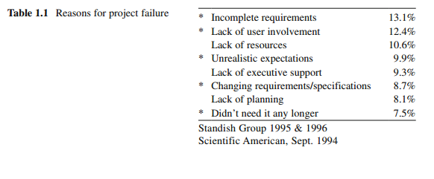

Slide 6
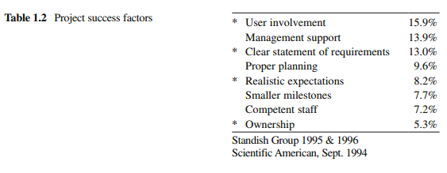

Slide 7
Because there are so many different types of requirements, it isn’t possible to describe a standard way of writing requirements or to define the ‘best’ way to specify requirements.
It depends on
  who is writing the requirements,
  who is likely to read them,
  the general practices of the organization developing the requirements, and
  the application domain of the system.

Slide 8
The problem of writing requirements are universal and there is no complete solution for these problems.
But Good Requirements engineering practices can reduce the number of problems and minimize their impact on the final system.

Slide 9
Requirements Definition
Requirements are
  description of the services provided by the system and its operational constraints reflecting needs of the customer that helps to solve their problem.
  condition or a capability possessed by software or system component in order to solve a real world problem.
  a statement that identifies a product or process operational, functional, or design characteristic or constraint, which is unambiguous, testable or measurable, and necessary for product or process acceptability (by consumers or internal quality assurance guidelines).

Slide 10
IEEE definition
  (1) A condition or capability needed by a user to solve a problem or achieve an objective.
  (2) A condition or capability that must be met or possessed by a system or system component to satisfy a contract, standard, specification, or other formally imposed documents.

Slide 11
Requirements Engineering
Requirements Engineering
  is the process of finding out, analyzing, documenting and checking services and operational constraints called requirements for a computer based system.
Requirements Engineering phase is the first software engineering activity, which translates the ideas or views into a requirements document.

Slide 12
Requirements Engineering Vs Systems Engineering
Requirements Engineering the subset of systems engineering concerned with discovering, developing, tracing, analyzing, qualifying, communicating and managing requirements that define the system at successive levels of abstraction.
Systems engineering is concerned with systems as a whole including hardware, software and operational processes.

Slide 13
The Systems Engineering Process

Slide 14
System Engineering Activities
System requirements engineering
  The requirements for the system as a whole are established and written to be understandable to all stakeholders
Architectural design
  The system is decomposed into sub-systems
Requirements partitioning
  Requirements are allocated to these sub-systems
Software requirements engineering
  More detailed system requirements are derived for the system software
Sub-system development
  The hardware and software sub-systems are designed and implemented in parallel.
System integration
  The hardware and software sub-systems are put together to make up the system.
System validation
  The system is validated against its requirements.

Slide 15
Summary
What are requirements?
  A statement of a system service or constraint
What is requirements engineering?
  The processes involved in developing system requirements
How much does requirements engineering cost?
  About 15% of system development costs
What happens when the requirements are wrong?
  Systems are late, costly, unreliable and don’t meet customers needs
Is there an ideal requirements engineering process?
  No - processes must be tailored to organisational needs

Slide 16
Types of Requirements

Slide 17
Requirements commonly considered are classified into two categories
    Functional requirements
    Nonfunctional requirements

Slide 18
Functional Requirements (Behavioral requirements)
Describe
  The functionality or services that software should provide.
  The interaction of software with its environment
  Functions that should and should not be included in the software.

Slide 19
IEEE definition
  “a function that a system or component must be able to perform.”
Should be complete and consistent.
  Completeness
    all the Functional requirements should defined.
  Consistency
    all the Functional requirements should be specified clearly without any contradictory definition.

Slide 20
2. Non-functional Requirements
(Quality Attributes)
Related to system attributes, such as reliability and response time which makes the software to perform efficiently.
Are not directly related to functions provided by the system
Arise due to
  User requirements
  Budget constraints
  Organizational policies

Slide 21
Classifications of NFR

Slide 22
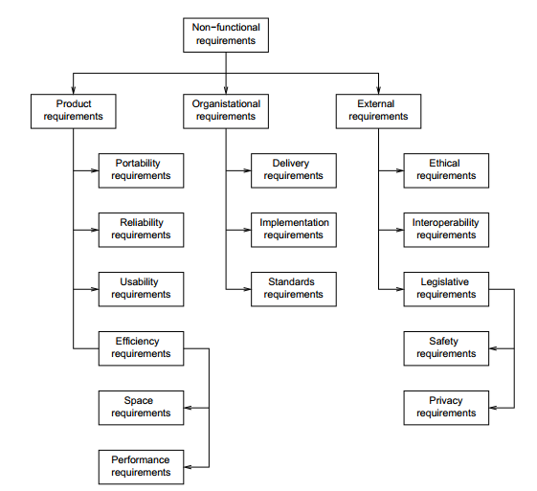

Slide 23
1. Product requirements
Specify how software product performs.
comprises
  Efficiency requirements
    the extent of optimal use of resources
    the speed with which system executes and
    the memory consumptions for its operation.
    E.g. The system should be able to operate at least three times faster than the existing system.

Slide 24
  Reliability requirements
    acceptable failure rate of the software.
    E.g. The software should be able to operate even if a hazard occurs.
  Portability requirements
    the ease with which software can be transferred
    from one platform to another.
    E.g. It should be easy to port software to different operating system without the need to redesign the entire software.
  Usability requirements:
    the ease with which users are able to learn to operate the
    software.
    E.g. The software should be able to provide access to functionality with fewer keystrokes and mouse clicks.

Slide 25
2. Organizational requirements
Derived from the policies and procedures of an organization.
comprise of the following
  Delivery requirements
    Specify when software and its documentation are to be delivered to the user
  Implementation requirements
    Describe requirements, such as programming language and design method.
  Standards requirements:
    the process standards to be used during software development.
    E.g. The software should be developed using standards specified by ISO (International Organization for Standardization) and IEEE standards.

Slide 26
3. External requirements:
include all the requirements that affect the software or its development process externally.
comprise of the following
  Interoperability requirements
    Define the way in which different computer-based systems interact with each other in one or more organizations.
  Ethical requirements:
    Specify the rules and regulations of the software so that they are acceptable to users.
  Legislative requirements:
    Ensure that software operates within the legal jurisdiction.
    E.g. Web pages developed for the federal government must comply with the law for equality of treatment of people with disabilities (obstacle free Internet, from 1/1/2006)

Slide 27
Non-functional requirements examples
Product requirement
  The user interface for LIBSYS shall be implemented as simple HTML without frames or Java applets.
Organizational requirement
  The system development process and deliverable documents shall conform to the process and deliverables defined in XYZCo.
External requirement
  The system shall not disclose any personal information about customers apart from their name and reference number to the operators of the system.

Slide 28
Some of NFR metrics used to verify and test requirements written quantitatively are:

Slide 29
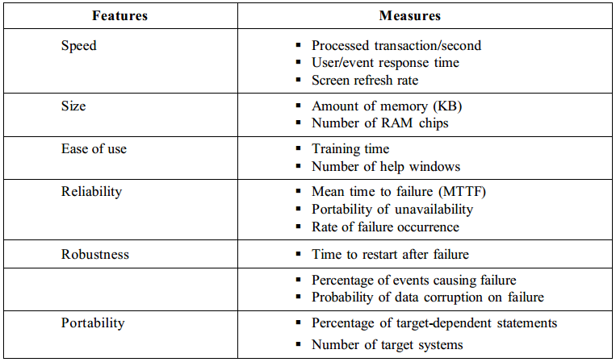

Slide 30
Requirements for Critical Systems
Critical systems
  Systems whose ‘failure’ causes significant economic, physical or human damage to organizations or people.
  There are three principal types of critical system:
    Business critical systems
    - Failure of the system leads to significant economic damage to business
    Mission critical systems
    - Failure leads to the abortion of a mission
    Safety critical systems
    - Failure endangers human life and causes significant environmental damage.

Slide 31
The cost of failure in CS is likely to exceed the cost of the system itself.
Examples of CS
  Communication systems such as aircraft radio systems
  Embedded control systems such as air-traffic control systems
  Financial systems such as banking systems
Criticality attributes
  Reliability
  Availability
  Maintainability
  Safety
  Security

Slide 32
Reliability
  Number of times a system fails to deliver the specified services expected by end-users.
  Metrics used
    MTTF – Mean Time To Failure
      time between observed system failures
    Rate of occurrence of Failure – number of failures in a given time period
Availability (esp. for nonstop systems)
  Determine how likely the system is available to meet a demand for service when requested by end-users.
  Metrics used
    POFOD – Probability Of Failure On Demand

Slide 33
Performance
  Constrain the speed of operation of a system.
  Response requirements
    Specify the acceptable response of the system to end-users input.
    E.g. The system should respond to user request for service within 2 seconds.
  Throughput requirements
    Specify the amount of data which must be processed in a given time
    E.g. The system should process at least 10 transactions per second.
Security
  To ensure unauthorized access to the system and its data is not allowed and ensure the integrity of the system from accidental or malicious damage.
  E.g.
  The access permissions for system data may only be changed by the system’s data administrator.
  All external communications between the system’s data server and clients must be encrypted

Slide 34
Safety
  Ability to deliver its services in such away the human life and its environment will not be damaged by the system.
  E.g. The system shall not operate if the external temperature is below 4 degree Celsius.

Slide 35
Characteristics of Good Requirements
Complete
  Functionality is described completely
Correct
  According to stakeholders‘ intentions
Consistent
  There are no two requirements that can not be reached in one single system
Testable
  Requirements can be used to generate tests on the final software

Slide 36
Comprehensible
  Requirements are to be understood by all stakeholders
Necessary
  Requirement should be needed by customer and user
Traceable
Well-Defined
  Requirement can only be understood in one single way
  Leaves no space for interpretation

Slide 37
CHAPTER 2
REQUIREMENTS ENGINEERING PROCESSES

Slide 38
Process
A Process
  An organized set of activities which transforms inputs to outputs
  A mechanism for dealing with problem complexity
  Once these activities are used to solve a problem, can be documented as a process description and used by others facing same problems.
Examples of process descriptions
  Instruction manual for a Cookery book

Slide 39
Requirements Engineering Processes
A series of activities performed in requirements Engineering phase to
  understand the requirements and its types
  express requirements in SRS document using appropriate techniques.
The processes used for RE vary widely depending on the
  application domain
  the people involved and
  the organization developing the requirements.
But there is conventional Generic activities common to all processes

Slide 40
RE Process - Inputs and Outputs

Slide 41
RE Process Input/output description

Slide 42
Reading Assignment
Types of Process Models in Requirements Engineering include:
  Coarse-grain activity models
  Fine-grain activity models
  Role-action models
  Entity-relation models

Slide 43
Definition of a Stakeholder
Stakeholder: An individual, group of people, organization or other entity that has a direct or indirect interest (or stake) in a system and stakeholders vary according to the nature of the system.
A stakeholder’s interest in a system may arise from using the system, benefiting from the system (in terms of revenue or other advantage), being disadvantaged by the system (in terms, for instance, of cost or potential harm), being responsible for the system, or otherwise being affected by it.

Slide 44
Managers: People who have a responsibility for either the development budget or operating budget of the proposed system. It is also a good plan to involve senior policy makers who will take a view on whether the proposed development conforms to the aims and philosophy of the company or organization.
Investors: People who either have made or are being invited to make a contribution to the funding of the proposed system, or the organizations responsible for dev eloping or operating the system.

Slide 45
System users: Clearly this is a very important group of stakeholders. They have a direct interest in the capabilities provided by the new system or service. Note that there may also be users who do not interact directly with the system.
For example, the users of the Hubble telescope are astronomers. They ask for photographs to be taken in specific directions, and they receive the information when it arrives, but they do not directly control the telescope itself. Users of an existing system are also valuable sources of knowledge of problems with that system. They can give invaluable insight into how they would like to see the system improved.

Slide 46
Maintenance and Service staff: Although their prime responsibility is to keep the system running once it has been delivered, they do have important requirements that the system must address in order to help them do their job.
Product disposers: This is an increasingly important role as environmental protection legislation develops. Requirements from this source can have a massive impact on design especially with respect to the materials employed.
Training personnel: Like the maintenance staff, these people have a vested interest in making the system easy to use and consequently easy to train people to use. These people may also require the system to be able to work simultaneously in a mode where live data and training data can be mixed without interfering with the safe operation of the system.

Slide 47
System buyers: For public services and other large systems, the person who buys the system may not be involved directly with its development or operation. They will, though, have an important role to play in scoping the system from the point of view of cost versus perceived benefit. For product-based developments, the buyer may be the actual user, e.g. mobile phone user, car driver etc.
Sales and marketing: These people have a vital role to play in formulating the capabilities for new systems, especially for product based developments, because, for mass produced consumer products, it is not possible to have access to all potential users.

Slide 48
Usability and efficiency experts: These people have a view on how the system can be optimized to make it efficient in use. These factors include ergonomics, ease of learning and, where relevant, ability to be used reliably under pressure (e.g. in air traffic control).
Operational environment experts: Usually a new system is not created to work in a “green fields” situation; it will have to inter-operate with existing systems. There may also be other environmental aspects such as emission control where the system must not pollute the environment, and conversely, aspects where the system must be able to tolerate the environment in which it is placed (e.g. in extreme weather conditions, submersed in water etc.)

Slide 49
Government: Rules, regulations and laws determine and influence what a system may or may not do.
Standards bodies: Existing and future standards can affect the goals of a proposed system. These may be international such as the GSM mobile phone standards, national standards or internal company standards.
Regulatory authorities: These organizations may require that certain evidence be collected as part of a certification or authorization process. Examples include the Rail Regulator in the UK and the Food and Drug Administration (FDA) in the USA.

Slide 50
Actors in the RE process

Slide 52
Cont…
The Generic activities common to all processes
  Feasibility Study
  Requirements Elicitation
  Requirements Analysis
  Requirements Specification
  Requirements Validation
  Requirements Management

Slide 53
I. Feasibility Study
Feasibility
  The practical extent to which a project can be performed successfully.
Feasibility Study
  Determines whether the solution considered to accomplish the requirements is practically workable in the software or not
  Decides whether or not the proposed system is worthwhile.

Slide 54
Types of Feasibility
Commonly known types are
  Technical feasibility
  Operational feasibility
  Economic feasibility.

Slide 55
(a) Technical Feasibility:
Technical feasibility assesses the current resources (such as hardware and software) and technology, which are required to accomplish user requirements in the software within the allocated time and budget.
Software development team ascertains whether the current resources and technology can be upgraded or added in the software to accomplish specified user requirements. Technical feasibility performs the tasks listed below:
  Analyzes the technical skills and capabilities of software development team members.
  Determines whether the relevant technology is stable and established or not.
  Ascertains that the technology chosen for software development has large number of users so that they can be consulted when problems arise or improvements are required

Slide 56
(b) Operational Feasibility
Operational feasibility assesses the extent to which the required
software performs series of steps to solve business problems and user requirements.

Slide 57
(c) Economic Feasibility
Economic feasibility determines whether the required software
is capable of generating financial gains for an organization or not. It involves the cost incurred on software development team, estimated cost of hardware and software, cost of performing feasibility study, and so on. For this, it is essential to consider expenses made on purchases (such as hardware purchase) and activities required to carry out software development.

Slide 58
CHAPTER 3
REQUIREMENTS ELICITATION
It is also known as Requirements capture or Requirements acquisition
Process of collecting information about software requirements from different individuals, such as users and other stakeholders.
System developers and engineers work with customers and end-users to find out the problem to be solved, the system services , the required performance of the system, hardware constraints and so on.

Slide 59
Elicitation Techniques
Techniques used to gather data
  Interviews
  Scenarios
    These are descriptions of a sequence of events happen in that business area
  Questionnaire
  Brainstorming
    Conference held around a table with 6-10 members and explain their ideas to be decided by voting
  Observation
  Ethnography
    Also known as Participant observation
  Prototype:
    Creating prototypes of software applications, i.e., incomplete version of the program being developed.
    representation or visualization of the actual system parts to gather requirements by presenting GUI based functions.
  JAD(Joint Application Development)
    Same as Brainstorming but stakeholders and users are also participants.

Slide 60
A Generic Requirements Elicitation Process
Objective setting
  The organizational objectives should be established including general goals of the business, an outline description of the problem to be solved, why the system is necessary and the constraints on the system.
Background knowledge acquisition
  Background information about the system includes information about the organization where the system is to be installed, the application domain of the system and information about existing systems
Knowledge organization
  The large amount of knowledge which has been collected in the previous stage must be organized and collated.
Stakeholder requirements collection
  System stakeholders are consulted to discover their requirements.

Slide 61
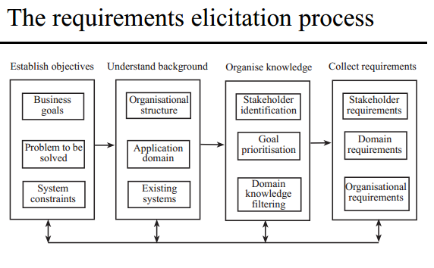

Slide 62
The output from the requirements elicitation process should be a draft document that describes the system requirements which is then will be analyzed.

Slide 63
III. REQUIREMENTS ANALYSIS & NEGOTIATION
Requirements Analysis
  The process of studying, specifying and refining the customer and the user needs to arrive at a definition of the problem domain and system requirements.

Slide 64
IEEE definition
  Requirements analysis
    The process of studying and refining user needs to arrive at a definition of a system, hardware, or software requirements.

Slide 65
Objective
  To establish an agreed set of requirements which are complete and consistent.
  Discover missing, conflicting, ambiguous, overlapping and unrealistic requirements.
  Develop analysis model to analyze the requirements in the software
  If there are any of the above problems, stakeholders must negotiate and agree on modifications and simplifications to the system requirements.

Slide 66
System modelling supports the analysis and design process by introducing a degree of formality into the way systems are defined.
Pictures are used to help visualize some aspects of the development.
Modelling provides a way of formalizing these representations, through diagrams, by not only defining a standard syntax, but also providing a medium for understanding and communicating the ideas associated with system development.

Slide 67
Activities Performed in Requirements Analysis
Necessity checking
  The need for the requirement is analyzed. In some cases, requirements may be proposed which don’t contribute to the business goals of the organization or to the specific problem to be addressed by the system.
Consistency and completeness checking
  The requirements are cross-checked for consistency and completeness. Consistency means that no requirements should be contradictory; completeness means that no services or constraints which are needed have been missed out.
Feasibility checking
  The requirements are checked to ensure that they are feasible in the context of the budget and schedule available for the system development.

Slide 68
Activities during Requirements Negotiation
Requirements discussion
  Requirements which have been highlighted as problematical are discussed and the stakeholders involved present their views about the requirements.
Requirements prioritization
  Disputed requirements are prioritized to identify critical requirements
  and to help the decision making process.
Requirements agreement
  Solutions to the requirements problems are identified and a compromise set of requirements are agreed. Generally, this will involve making changes to some of the requirements.

Slide 69
CHAPTER 4
Requirements Specification

Slide 70
Requirements Specification
  is the process of writing down the user and system requirements using exact and detailed statements in a Requirements Document called Software Requirements Specification (SRS).

Slide 71
SRS Definition
IEEE definition
  “a document that clearly and precisely describes each of the essential requirements (functions, performance, design constraints, and quality attributes) of the software and the external interfaces. Each requirement is defined in such a way that its achievement can be objectively verified by a prescribed method.”

Slide 72
Purposes served by SRS
Feedback
Decompose problem into components
Validation
Input to design
Basis for agreement between user and organization
Reduce the development effort
Estimating costs and schedules

Slide 73
SRS Users
System customers - to specify and verify whether requirements meet the desired needs or not.
Managers - to plan for the system development processes.
System engineers - to understand what system is to be developed
System Test Engineers - to develop validation test for the developed system.
System maintenance engineers - to use the requirement and the relationship between its parts.

Slide 74
Characteristics of SRS
Complete
Correct
Unambiguous
Ranked for importance/stability
Modifiable
Traceable
Verifiable
Consistent

Slide 75
Structure of SRS
Organized into independent sections and subsections.
Level of detail and information to be included in the SRS depends on
  the type of the system to be developed and the process model chosen for its development.
The most widely used standard is by IEEE

Slide 76
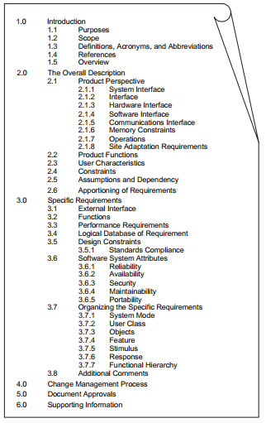

Slide 77
CHAPTER 5
REQUIREMENTS VALIDATION

Slide 78
Requirements Validation
Process conducted to checking and validating all the issues related to requirements in the SRS document.
Validation objectives
  Certifies that the requirements document represent an acceptable description of the system to be implemented.
  Checks a requirements document for
    Completeness and consistency
    Conformance to standards
    Requirements conflicts
    Technical errors
    Ambiguous requirements

Slide 79
Requirements Validation Objective
To ensure that the SRS reflects the actual requirements accurately and clearly.
Certify that the SRS contains an acceptable description of the system to be implemented.
Ensure that the actual requirements of the system are reflected in SRS
Check requirements document for completeness, accuracy, consistency, requirement conflict, conformance to standards, and technical errors.

Slide 80
Analysis and Validation
Analysis works with raw requirements as elicited from the system stakeholders
  “Have we got the right requirements” is the key question to be answered at this stage
Validation works with a final draft of the requirements document i.e. with negotiated and agreed requirements
  “Have we got the requirements right” is the key question to be answered at this stage

Slide 81
Validation inputs and outputs

Slide 82
Validation Inputs
Requirements document
  Should be a complete version of the document, not an unfinished draft. Formatted and organised according to organisational standards
Organisational knowledge
  Knowledge, often implicit, of the organisation which may be used to judge the realism of the requirements
Organisational standards
  Local standards e.g. for the organisation of the requirements document

Slide 83
Validation Outputs
Problem list
  List of discovered problems in the requirements document
Agreed actions
  List of agreed actions in response to requirements problems. Some problems may have several corrective actions; some problems may have no associated actions

Slide 84
Validation Techniques
Requirement Review
Requirements Testing / Test Case Generation

Slide 85
1. Requirements Reviews
Validating the requirements by a group of people(Review Team).
A group of people read and analyse the requirements, look for problems, meet and discuss the problems and agree on actions to address these problems.

Slide 86
Requirements review process

Slide 87
Review Activities
Plan review
  The review team is selected and a time and place for the review meeting is chosen.
Distribute documents
  The requirements document is distributed to the review team members
Prepare for review
  Individual reviewers read the requirements to find conflicts, omissions, inconsistencies, deviations from standards and other problems.
Hold review meeting
  Individual comments and problems are discussed and a set of actions to address the problems is agreed.
Follow-up actions
  The chair of the review checks that the agreed actions have been carried out.
Revise document
  The requirements document is revised to reflect the agreed actions. At this stage, it may be accepted or it may be re-reviewed

Slide 88
Review checklists
Understandability
  Can readers of the document understand what the requirements mean?
Redundancy
  Is information unnecessarily repeated in the requirements document?
Completeness
  Does the checker know of any missing requirements or is there any information missing from individual requirement descriptions?
Ambiguity
  Are the requirements expressed using terms which are clearly defined? Could readers from different backgrounds make different interpretations of the requirements?

Slide 89
Review checklists
Consistency
  Do the descriptions of different requirements include contradictions? Are there contradictions between individual requirements and overall system requirements?
Organisation
  Is the document structured in a sensible way? Are the descriptions of requirements organised so that related requirements are grouped?
Conformance to standards
  Does the requirements document and individual requirements conform to defined standards? Are departures from the standards, justified?
Traceability
  Are requirements unambiguously identified, include links to related requirements and to the reasons why these requirements have been included?

Slide 90
Roles and Responsibilities in a Review
1. The Moderator(Review Leader)
  Determine type of review approach
  Disseminate documents before the meeting
2. The Author
  Writer of the document under review
3. The Scribe|Recorder
  Record each defect found and given suggestions and feedback.
4. The Reviewers
  Check the SRS for defects and further improvement.
5. The Manager
  Decide the execution of Reviews
  Determine if Review objective is met.

Slide 91
Requirements problem example
“4. EDDIS will be configurable so that it will comply with the requirements of all UK and (where relevant) international copyright legislation. Minimally, this means that EDDIS must provide a form for the user to sign the Copyright Declaration statement. It also means that EDDIS must keep track of Copyright Declaration statements which have been signed/not-signed. Under no circumstances must an order be sent to the supplier if the copyright statement has not been signed.”

Slide 92
Problems
Incompleteness
  What international copyright legislation is relevant?
  What happens if the copyright declaration is not signed?
  If a signature is a digital signature, how is it assigned?
Ambiguity
  What does signing an electronic form mean? Is this a physical signature or a digital signature?
Standards
  More than 1 requirement. Maintenance of copyright is one requirement; issue of documents is another

Slide 93
2. Requirements Testing (Test Case Generation)
A test case is a document that describes an input, action, or event and its expected result, in order to determine whether the software or a part of the software is working correctly or not.
Generate a Test-case for each requirements and prepare a Test Record Form to be filled in for each requirement which is tested.

Slide 94
Information to be included in Test Record Form
  The requirement’s identifier
    There should be at least one for each requirement.
  Related requirements
    These should be referenced as the test may also be relevant to these requirements.
  Test description
    A brief description of the test and why this is an objective requirements test. This should include system inputs and corresponding outputs.
  Requirements problems
    A description of problems which made test definition difficult or impossible.
  Comments and recommendations
    These are advice on how to solve requirements problems which have been discovered.

Slide 95
CHAPTER 6
REQUIREMENTS MANAGEMENT

Slide 96
Definition
Process of eliciting, documenting, organizing and controlling changes to the requirements.
To
  Identify,
  Control and
  Track requirements and changes on requirements.
Managing changes to system’s requirements evolving because of changes to system’s environment and as customers develop a better understanding of their real needs.

Slide 97
The principal concerns of requirements management are:
  Managing changes to agreed requirements
  Managing the relationships between requirements
Requirements changes can occur while requirements
  Elicitation,
  Analysis and Validation and
  After the system has gone into Service

Slide 98
Requirements change factors
Requirements errors, conflicts and inconsistencies
  As requirements are analysed and implemented, errors and inconsistencies emerge and must be corrected.
Evolving customer/end-user knowledge of the system
  New requirements emerge ad stakeholders develop a better understanding of the system.
Technical, schedule or cost problems
  Problems may be encountered in implementing a requirement. It may be too expensive or take too long to implement certain requirements.

Slide 99
Requirements change factors
Changing customer priorities
  Customer priorities change during system development as a result of a changing business environment, the emergence of new competitors, staff changes, etc.
Environmental changes
  The environment in which the system is to be installed may change so that the system requirements have to change to maintain compatibility
Organisational changes
  The organisation which intends to use the system may change its structure and processes resulting in new system requirements

Slide 100
From an evolution perspective, requirements fall into two classes
  Stable requirements are derive from the core activity of the organization and application domain of the system. They change more slowly than volatile requirements.
  Volatile requirements are specific to the instantiation of the system in a particular environment and for a particular customer.

Slide 101
Types of Volatile requirement
Mutable requirements
  change because of changes to the environment in which the system is operating
Emergent requirements
  cannot be completely defined when the system is specified but which emerge as the system is designed and implemented.
Consequential requirements
  are based on assumptions about how the system will be used. When the system is put into use, some of these assumptions will be wrong.
The compatibility requirements
  depend on other equipment or processes.

Slide 102
The Change Management Process
Some requirements problem or change is identified.
  This could come from an analysis of the requirements, new customer needs, or operational problems with the system. The requirements are analysed using problem information and requirements changes are proposed.
The proposed changes are analysed
  This checks how many requirements (and, if necessary, system components) are affected by the change and roughly how much it would cost, in both time and money, to make the change.
The change is implemented.
  A set of amendments to the requirements document or a new document version is produced. This should, of course, be validated using whatever normal quality checking procedures are used.

Slide 103
Change Management Stages

Slide 104
Change Request Rejection
If the change request is invalid.
  This normally arises if a customer has misunderstood something about the requirements and proposed a change which isn’t necessary.
If the change request results in consequential changes which are unacceptable to the user.
If the cost of implementing the change is too high or takes too long.

Slide 105
Advantages of Requirements Management
Better control of complex projects
Improves software quality
Reduced project costs and delays
Improved team communications
Easing compliance with standards and regulations

Slide 106
Traceability
Traceability information is information which helps you assess the impact of requirements change on the rest of the system.
Types of traceability information
  Backward-from traceability : Links requirements to their sources in other documents or people.
  Forward-from traceability : Links requirements to the design and implementation components
  Backward-to traceability : Links design and implementation components backs to requirements
  Forward-to traceability : Links information from documents and other sources to relevant requirements.

Slide 107
Traceability Tables
Traceability tables show the relationships between requirements or between requirements and design components
Requirements are listed along the horizontal and vertical axes and relationships between requirements are marked in the table cells
Traceability tables for showing requirements dependencies should be defined with requirement numbers used to label the rows and columns of the table.

Slide 108
A traceability table

Slide 109
A Traceability list

